Slide 1
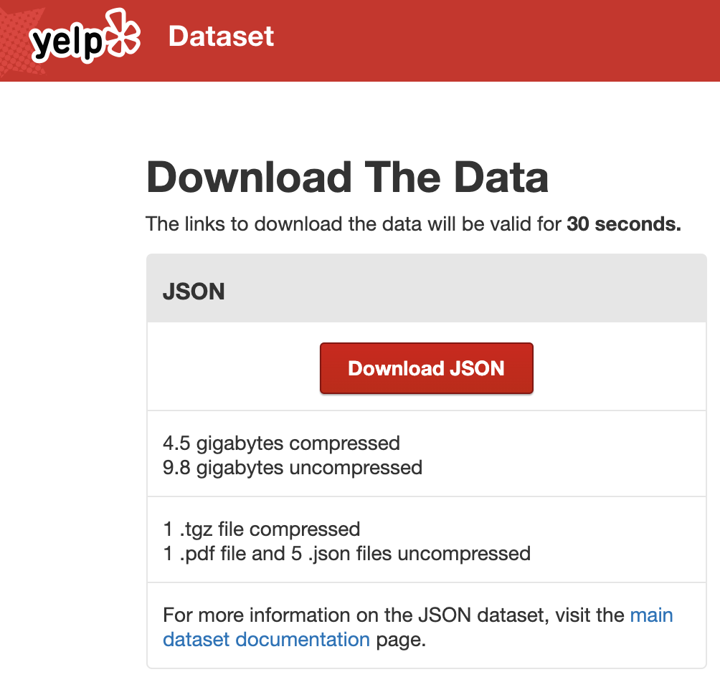
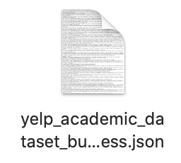

Date Collection
Business id
Name
Address
City
State
latitude
longitude
Stars
Reviewcount
Is_open
Attribute
Categories
Review_id
User_id
Business_id
Stars_X
Useful
Funny
Cool
Date
Name
Address
City
State
Latitude
longitude
Stars_y
Review-
count
Is_open
Attribute
Categories
Hours
Selected two useful files:
Yelp_academic_dataset_business.json
Yelp_academic_dataset_review.json

Slide 2
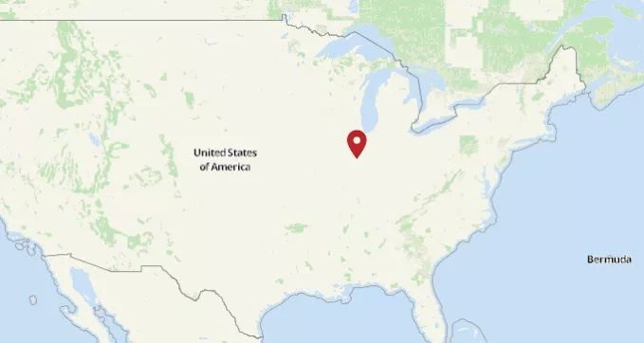
Data Selection
Selection criteria
Area: Champaign, Illinois, USA
Time Period: 2018-2019
Selection Results
431 restaurants
4871 reviews

Slide 3
Data Process
Goal: build the current network
(restaurants are the nodes and common reviewers are the edges)
Steps:
Delete all duplicate items
Select all reviewers
Count the number of reviews of each reviewers
Use “unique” function to select the reviewers only have one review
Delete the unique reviewers
Calculate the common reviewers of two restaurants
Use “for loop” function to build the current network

Slide 4
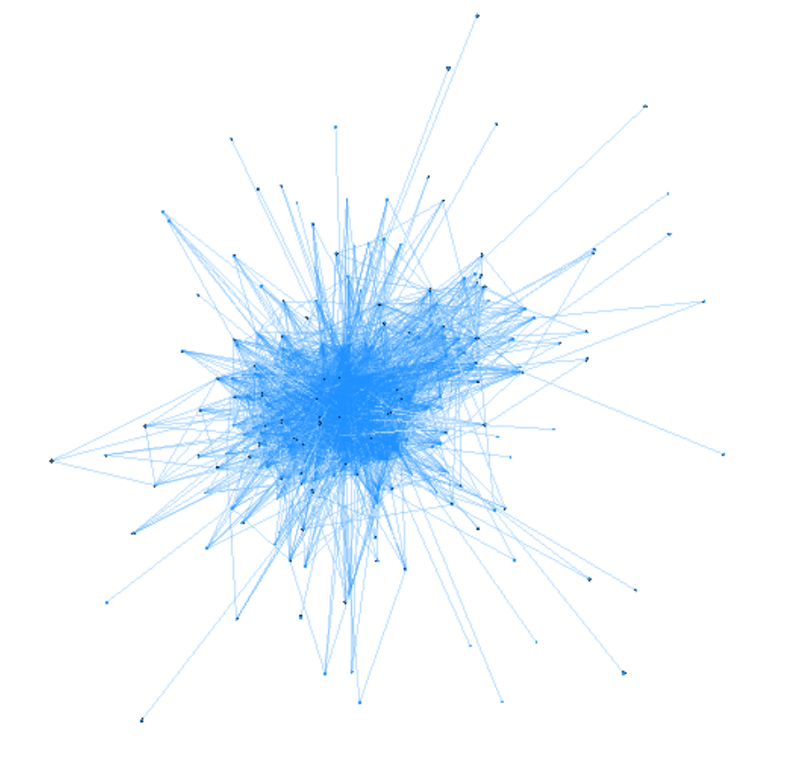
Data Process
Nodes
Edges
Betweenness

